Slide 1
Spam Detection
Gaurav Sachdeva ( 17103032) Rahul Shah (17103067)
Jatin Bansal(17103043) Yogesh chaudhary(17103095)

Slide 2
Abstract
We all face the problem of spams in our inboxes. So our aim is to build a spam classifier program in python which can tell whether a given message is spam or not!

Slide 3
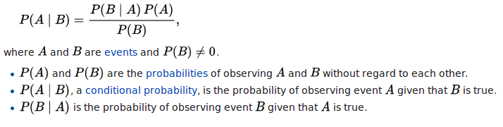
Main Approach
This can be done by using a simple and powerful theorem from probability theory called Baye’s Theorem. It is mathematically expressed as :

Slide 4

Problem Statement
We have a message m = (w1, w2, . . . . , wn), where (w1, w2, . . . . , wn) is a set of unique words contained in the message. We need to find :

Slide 5
Tech Stack :
Python
Jupyter Notebook
Dependencies :
NLTP ( for processing the messages)
WorkCloud and matplotlib (for visualization)
Numpy (for generating random probabilities for train-test split)
Panda (loading data )

Slide 6
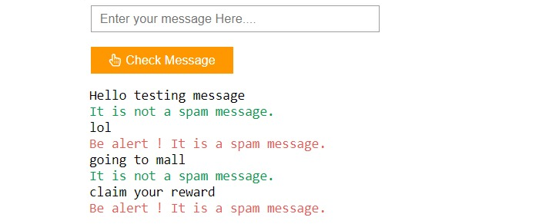
Output

Slide 7
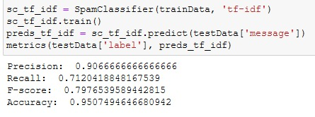
Accuracy and Precision:

Slide 8
Contributions
Problem Statement and Research : Yogesh Chaudhary
Initialization and Data Set : Gaurav Sachdeva
Visualization and Logic : Jatin Bansal
Model Training : Rahul Shah
Optimization : Jatin and Yogesh
Testing : Gaurav and Rahul
Documentation : Yogesh,Rahul,Jatin and Gaurav
Demonstration and Presentation : Yogesh,Rahul,Jatin and Gaurav

Slide 9
Thank You

